Slide 1
Movie Dekho
Prathamesh Hanmante (32)
Shubham Hazare(89)
Shubham Yache(90)
Abhishek Shujalpurkar(120)

Slide 2
AGENDA
Project Overview
Users and Use Cases
Project Architecture
Individual Role and contribution
Project Methodology
Testing Approach
Future Extensions
Experience and Lessons learnt

Slide 3
Project overview
In today's fast-paced digital age, the convenience of online services has become indispensable, extending to entertainment experiences such as booking movie tickets. The Movie Booking System offers a seamless solution for users to browse, select, and reserve seats for their favorite movies with ease and efficiency.
By leveraging modern technology and user-centric design principles, the Movie Booking System aims to enhance the overall movie-going experience, making it more accessible and enjoyable for audiences while optimizing the management of cinema resources.

Slide 4
Users and Use cases

Slide 5
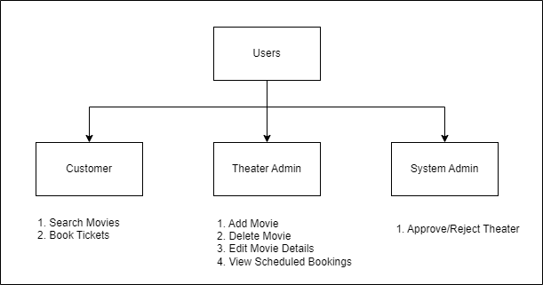

Slide 6
Project Architecture
FRONT END
MIDDLE TIER WITH MICROSERVICES ARCHITECTURE
DATABASE TIER
Web Server running on localhost : 3000
.NET Rest API Server on localhost : 7150
Entity Framework
MySQL
Spring boot Rest API Server running on localhost : 8080
HTML,CSS
BOOTSTRAP
REACT JS Components
JPA
Running on 3306

Slide 7
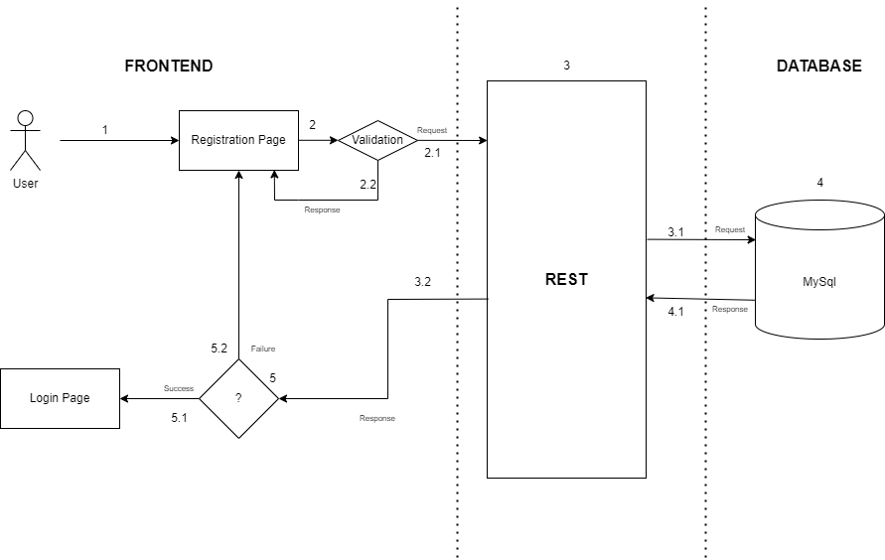
Registration workflow diagram

Slide 8
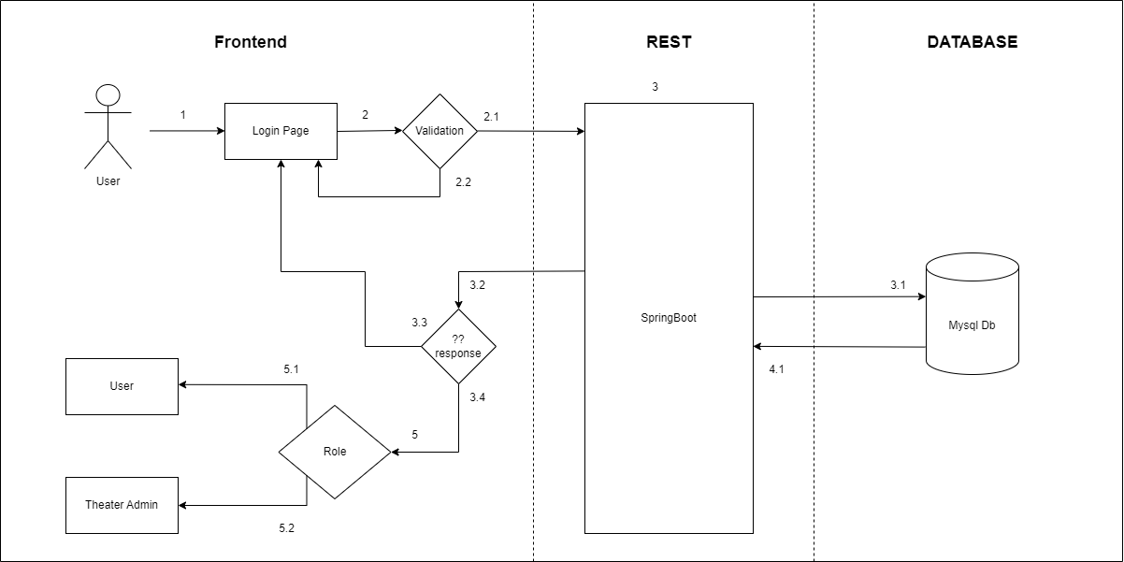
Login workflow diagram

Slide 9
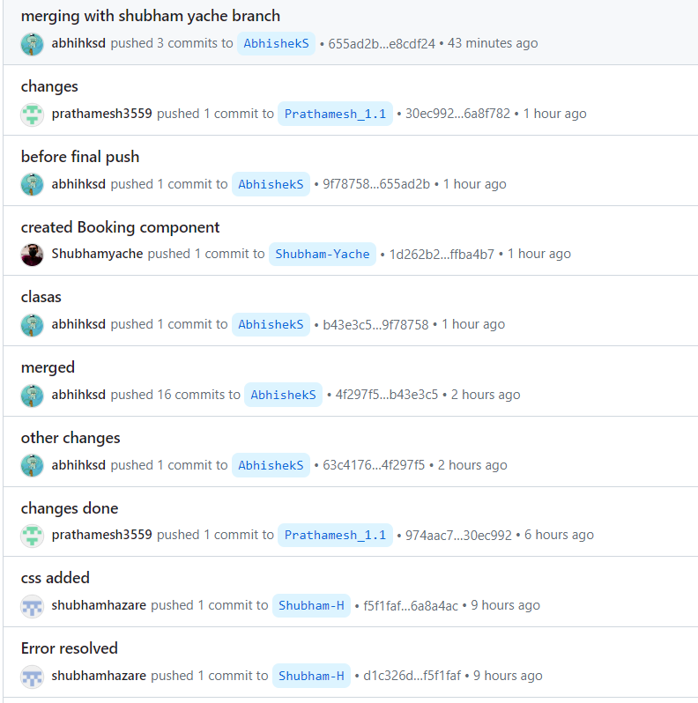
Project Methodology
GitHub Repository URL: https://github.com/abhihksd/MovieBookingWebsite.git
List of Branches:
AbhishekS
Prathamesh_1.1
Shubham-H
Shubham-Yache

Slide 10
Testing APPROACH
​REST API using Postman
Manual Testing for React Components

Slide 11
Future extensions
Rating and Reviews
Push Notifications
Integration with Social Media

Slide 12
Experience/lessons learnt
Team Working
Approaches to solve a problem
Introduction to Git and GitHub

Slide 13
THANK YOU

